Slide 1

The first series of questions on statistical pattern recognition
Arezoo Zareian

Slide 2

True or False?!
To predict the probability of an event, one would prefer a
regression model trained with squared error to a classifier
trained with logistic regression.

Slide 3

True or False?!
To predict the probability of an event, one would prefer a
regression model trained with squared error to a classifier
trained with logistic regression.

Slide 4

True or False?!
As linear regression is given more and more data, its
training error will eventually approach 0.

Slide 5
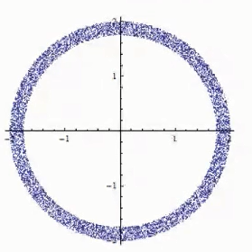
True or False?!
As linear regression is given more and more data, its
training error will eventually approach 0.

Slide 6

True or False?!
With correct fixed learning rate, gradient descent with the mse error always converge to the optimum of the objective function
for linear regression (If the optimum exist).

Slide 7

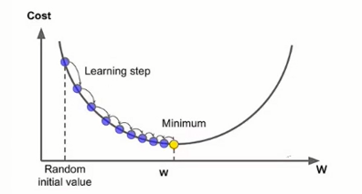
True or False?!
With correct fixed learning rate, gradient descent with the mse error always converge to the optimum of the objective function
for linear regression (If the optimum exist).

Slide 8
True or False?!
When we have less data and the model complexity stay the
same, over fitting is more likely.

Slide 9
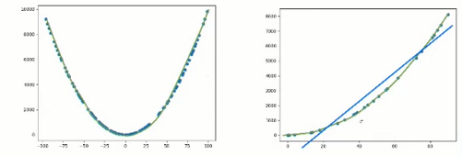
True or False?!
When we have less data and the model complexity stay the
same, over fitting is more likely.

Slide 10

Choose the best
The parameters to be estimated in the simple linear
regression model Y=α+ßx+ε, ε~N (0, σ) are:
a) α, ß, ε
b) α, ß
c) α, ß, σ
d) ε, σ

Slide 11
Choose the best
The parameters to be estimated in the simple linear
regression model Y=α+ßx+ε, ε~N (0, σ) are:
a) α, ß, ε
b) α, ß
c) α, ß, σ
d) ε, σ

Slide 12
Choose the best
The MSE is an estimator of:
a) Y
b) ε
c) σ
d) Y hat

Slide 13
Choose the best
The MSE is an estimator of:
a) Y
b) ε
c) σ
d) Y hat

Slide 14
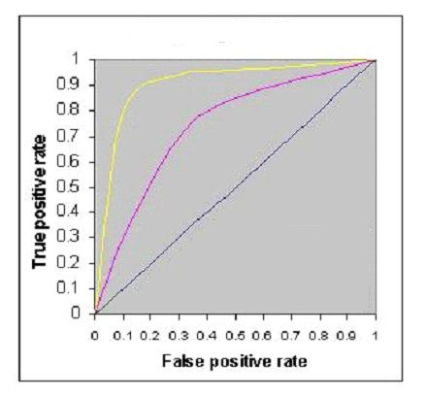
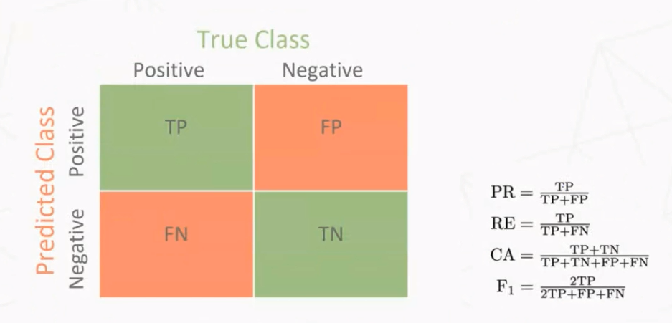
Choose the best
The below figure shows AUC-ROC curves for three logistic
regression models. Different colors show curves for different hyper parameters values. Which of the following AUC-ROC will give best result?
a) Pink
b) Yellow
c) Black
d) Are the same

Slide 15
Choose the best
The below figure shows AUC-ROC curves for three logistic
regression models. Different colors show curves for different hyper parameters values. Which of the following AUC-ROC will give best result?
a) Pink
b) Yellow
c) Black
d) Are the same

Slide 16
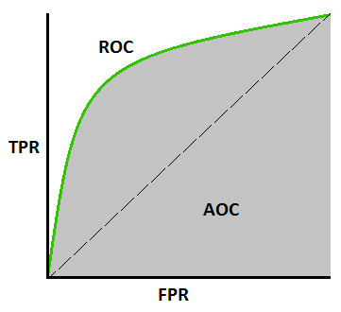
AUC-ROC
AUC - ROC curve is a performance measurement for the classification problems at various threshold settings. ROC is a probability curve and AUC represents the degree or measure of separability. It tells how much the model is capable of
distinguishing between classes.
Higher the AUC, the better the model is at predicting
0 classes as 0 and 1 classes as 1.
By analogy, the Higher the AUC, the better the model
is at distinguishing between patients with the disease and
no disease.

Slide 17


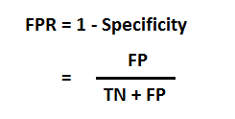
AUC-ROC
TPR (True Positive Rate) / Recall /Sensitivity :
Specificity :
FPR :

Slide 18
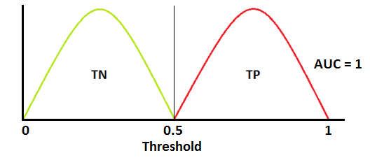
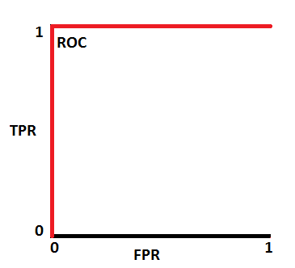
AUC-ROC
As we know, ROC is a curve of probability. So let's plot the distributions of those probabilities: (Red distribution curve is of the positive class (patients with disease) and the green distribution curve is of the negative class(patients with no disease))
This is an ideal situation. When two curves don’t overlap at all means model has an ideal measure of separability. It is perfectly able to distinguish between positive class and negative class.

Slide 19
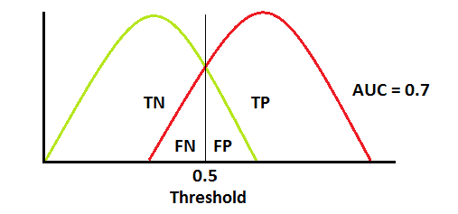
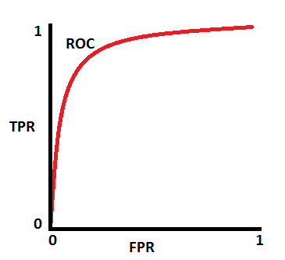
AUC-ROC
When two distributions overlap, we introduce type 1 and type 2 errors. Depending upon the threshold, we can minimize or maximize them. When AUC is 0.7, it means there is a 70% chance that the model will be able to distinguish between
positive class and negative class.

Slide 20
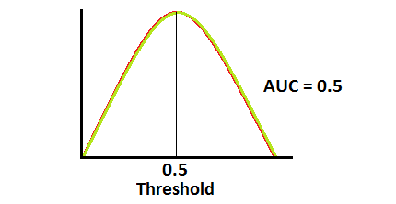
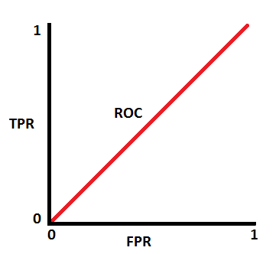
AUC-ROC

Slide 21
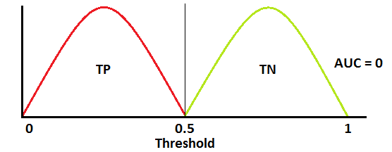
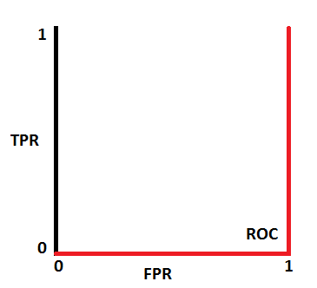
AUC-ROC
This is the worst situation. When AUC is approximately 0.5, the model has no discrimination capacity to distinguish between positive class and negative class.

Slide 22
Choose the best
Imagine, you have given the below graph of logistic regression which is shows the relationships between cost function and number of iteration for 3 different learning rate values (different colors are showing different curves at different learning rates ).
a) Pink
b) Yellow
c) Black
d) Are the same

Slide 23
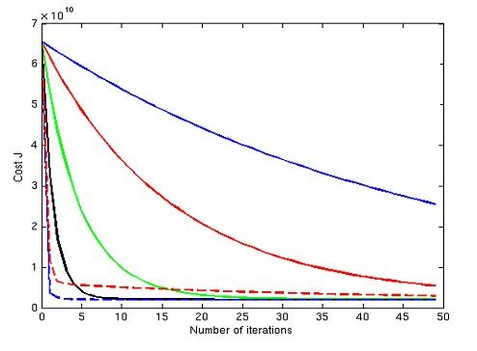
Choose the best
Imagine, you have given the below graph of logistic regression which is shows the relationships between cost function and
number of iteration for 3 different learning rate values (different colors are showing different curves at different learning rates ).
Suppose, you save the graph for future reference but you forgot to save the value of different learning rates for this graph. Now, you want to find out the relation between the leaning rate values of these curve. Which of the following will be the true relation?
Note : (The learning rate for blue is l1, The learning rate for red is
l2, The learning rate for green is l3)
A) l1>l2>l3
B) l1 = l2 = l3
C) l1 < l2 < l3
D) None of these

Slide 24
Choose the best
Imagine, you have given the below graph of logistic regression which is shows the relationships between cost function and
number of iteration for 3 different learning rate values (different colors are showing different curves at different learning rates ).
Suppose, you save the graph for future reference but you forgot to save the value of different learning rates for this graph. Now, you want to find out the relation between the leaning rate values of these curve. Which of the following will be the true relation?
Note : (The learning rate for blue is l1, The learning rate for red is
l2, The learning rate for green is l3)
A) l1>l2>l3
B) l1 = l2 = l3
C) l1 < l2 < l3
D) None of these

Slide 25
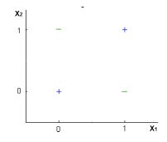
Choose the best
Can a Logistic Regression classifier do a perfect classification on the below data?
Note: You can use only X1 and X2 variables where X1 and X2 can take only two binary values (0,1).
A) TRUE
B) FALSE
C) Can’t say
D) None of these

Slide 26
Choose the best
Can a Logistic Regression classifier do a perfect classification on the below data?
Note: You can use only X1 and X2 variables where X1 and X2 can take only two binary values (0,1).
A) TRUE
B) FALSE
C) Can’t say
D) None of these

Slide 27
Short Answer
Describe how Gradient Descent and Stochastic Gradient Descent differ each other. Witch one converge faster and why? How would noisy data affect each of these algorithms?

Slide 28
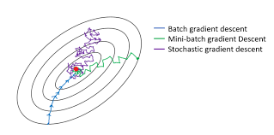
Short Answer
Describe how Gradient Descent and Stochastic Gradient Descent differ each other. Witch one converge faster and why? How would noisy data affect each of these algorithms?

Slide 29

Short Answer
What are some disadvantages of using Naive Bayes Algorithm?

Slide 30
Short Answer
What are some disadvantages of using Naive Bayes Algorithm?
1) It relies on a very big assumption that the independent variables are not related to each other.
2) It is generally not suitable for datasets with large numbers of numerical attributes.
3) It has been observed that if a rare case is not in the training dataset but is in the testing dataset, then it will most definitely be wrong.

Slide 31
Short Answer
What are some advantages of using Naive Bayes Algorithm?

Slide 32
Short Answer
What are some advantages of using Naive Bayes Algorithm?
1) It is a simple, fast, and very robust method of classification.
2) It does well with both clean and noisy data.
3) It requires a few examples for training, but the underlying assumption is that the training dataset is a true representative of the population.
4) It is easy to get the probability for a prediction.

Slide 33

Solve it :
Determine the linear function of the form (ax +b) which minimizes
the squared error for the following regression problem: (assume that b = 0)

Slide 34
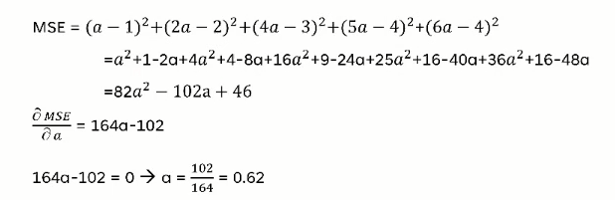
Solve it :
Determine the linear function of the form (ax +b) which minimizes
the squared error for the following regression problem: (assume that b = 0)

Slide 35
Thanks!!
Any Question?

